Slide 1

Applications of robots in industry
CHETHAN
4nm19me025@nmamamit.in

Slide 2
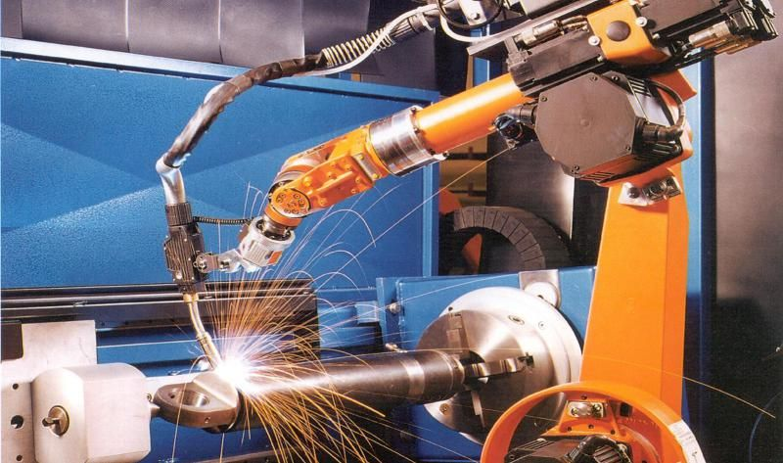
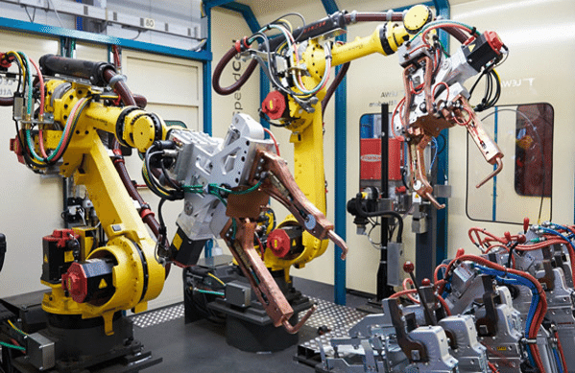
1. ROBOT WELDING
Robot Welding became commonplace in the 1980s. One of the driving forces for switching to robot welding is improving the safety of workers from arc burn and inhaling hazardous fumes.
Arc Welding
Robot arc welding has begun growing quickly just recently, and already it commands about 20% of industrial robot applications. The major components of arc welding robots are the manipulator or the mechanical unit and the controller, which acts as the robot's "brain". The manipulator is what makes the robot move, and the design of these systems can be categorized into several common types, such as SCARA and Cartesian coordinate robot, which use different coordinate systems to direct the arms of the machine
Spot Welding
Spot welding joins two contacting metal surfaces by directing a large current through the spot, which melts the metal and forms the weld delivered to the spot in a very short time (approximately ten milliseconds).
Robot welding is the use of mechanized programmable tools , which completely automate a welding process by both performing the weld and handling the part. Processes such as gas metal arc welding, while often automated, are not necessarily equivalent to robot welding, since a human operator sometimes prepares the materials to be welded. Robot welding is commonly used for resistance spot welding and arc welding in high production applications, such as the automotive industry.

Slide 3
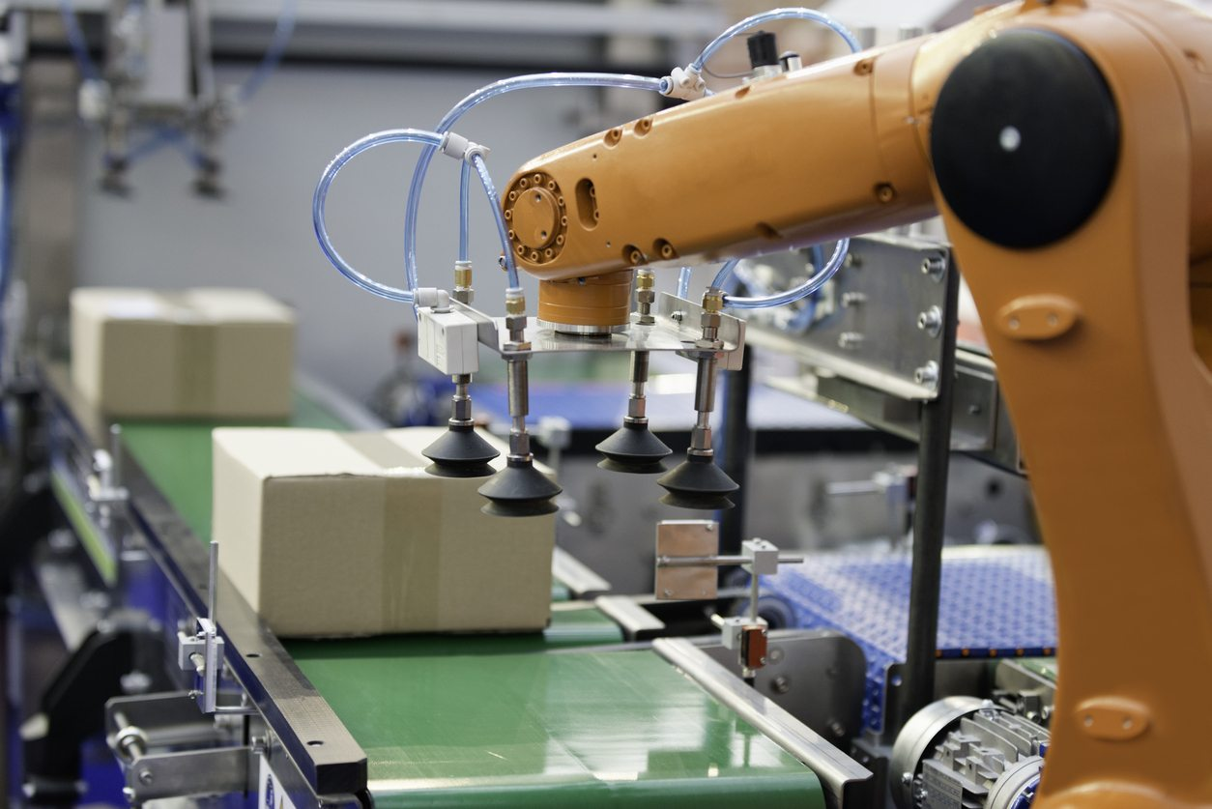
2. Material Handling
The term material handling encompasses a wide variety of product movements on the shop floor. Part selection and transferring, palletizing, packing, and machine loading are just a few of the applications that are considered material handling.
Material handling robots are utilized to move, pack and select products. They also can automate functions involved in the transferring of parts from one piece of equipment to another. Direct labor costs are reduced and much of the tedious and hazardous activities traditionally performed by human labor are eliminated.
Most products are handled multiple times prior to final shipping. Robotic picking and packaging increases speed and accuracy along with lowering production costs.
Material handling (MH) makes use of the robot's simple capability to transport objects. By fitting the robot with an appropriate end of arm tool (e.g. gripper), the robot can efficiently and accurately move product from one location to another.
Some material handling robots from top brands are FANUC, Yaskawa Motoman, ABB, and KUKA.

Slide 4
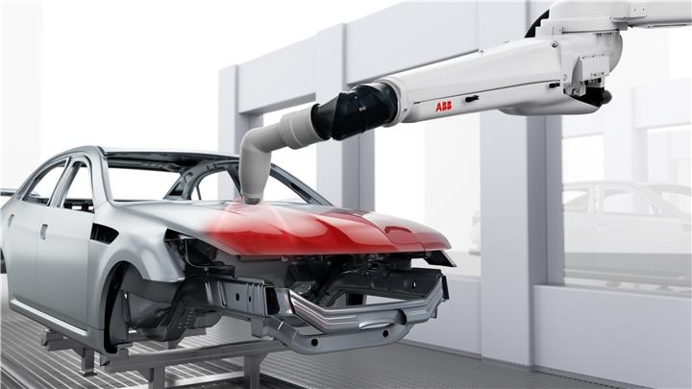
3. Painting
Robotic painting is used in automotive production and many other industries as it increases the quality and consistency of the product. Cost savings are also realized through less rework.
Industrial paint robots have been used for decades in automotive paint applications.
Industrial paint robots are designed to help standardize the distance and path the automatic sprayer takes. Eliminating the risk of human error caused by manual spraying. Paint robots are often paired with other automatic painting equipment to maximize the efficiency and consistency of the paint finish.
Rotational Bell atomizers, other automatic electrostatic or automatic conventional sprayers are mounted on the robot to provide the highest quality finish.
Painting robots generally have five or six axis motion, three for the base motions and up to three for applicator orientation. These robots can be used in any explosion hazard Class 1 Division 1 environment.
Finish is also extremely important in the aerospace and defense industry. These parts require very precise specifications for safety and performance reasons. Coatings can provide erosion resistance, anti-static dissipation, and even radar evading stealth. For this reason, consistent finish on all parts is vital to ensure continuity throughout.

Slide 5
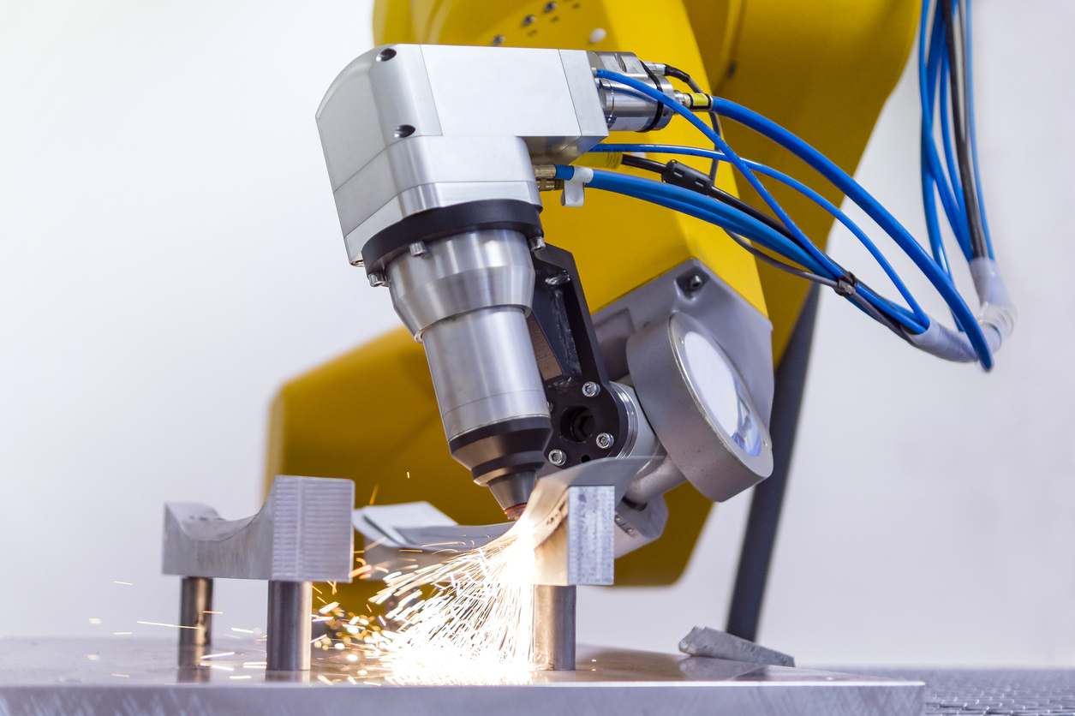
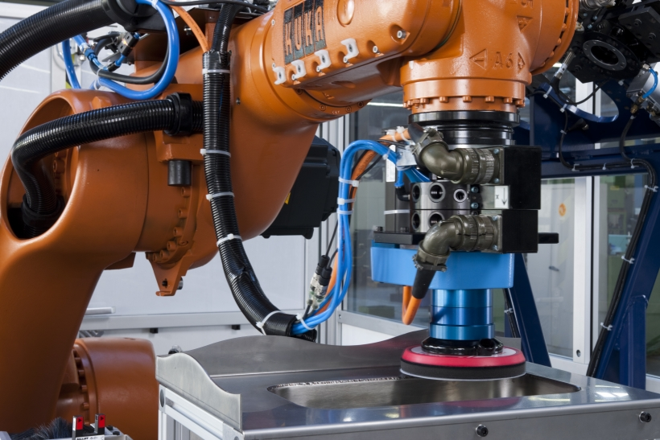
4. Mechanical Cutting, Grinding, Deburring and Polishing
Building dexterity into robots provides a manufacturing option that is otherwise very difficult to automate. An example of this is the production of orthopedic implants, such as knee and hip joints. Buffing and polishing a hip joint by hand can normally take 45-90 minutes while a robot can perform the same function in just a few minutes.
Robotic cutting is the automated process of removing material from a work piece or dividing the work piece into several smaller, distinct parts.
Cutting robots are extremely precise and accurate, while increasing speed. Decreased cutting errors reduces product waste. Depending on the product material, type of cut you wish to apply, will help determine the type of blade or cutter needed. Choose from a variety of customized or pre-engineered cutters to attach at the end of the robot arm.
Cutting robot systems also help keep employees safe from dust or fumes that can occur during a cutting application.
When it comes to the quality of your finished parts there’s no room for compromise. Yaskawa Motoman has partnered with world-class cutting technology and industrial integration providers to offer a suite of robot-guided ultrasonic knives and routing tools, designed to work with a multitude of cuts and materials.
FANUC finishing robots are also famous in industries.

Slide 6

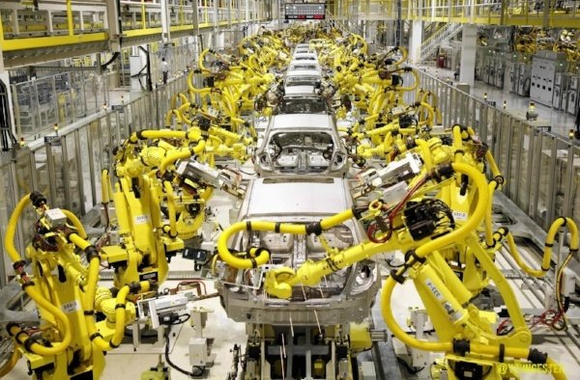
5. ROBOTS IN ASSEMBLY LINE
Robots routinely assemble products, eliminating tedious and tiresome tasks. Robots increase output and reduce operational costs.
When it comes to putting parts together, assembly line robots occupy a sweet spot between humans and dedicated or “hard” automation. An assembly robot moves faster and with greater precision than a human, and an off-the-shelf tool can be installed and commissioned quicker than special-purpose equipment. Easily reconfigured – many times, it only takes a change of the program – an automated robotic assembly is a low-risk investment that simultaneously satisfies the demands of manufacturing, quality and finance.
Robotic assembly systems come in three configurations: six-axis articulated arms, four-axis “SCARA” robots, and the modern “Delta” configuration. Looking like a ceiling-mounted spider, the delta robot uses motors in the base to move three linked arms. This creates a machine with unrivaled acceleration and speed, although payloads are less than those of articulated designs. Conventionally, deltas only have three or four axes but FANUC can provide as many as six axes of motion on its M-1iA and M-2iA robots, making them ideal for high-speed robotic assembly.
Assembly automation can be specified with vision systems and force sensing. Vision can guide a robot to pick up a component from a conveyor, reducing or even eliminating the need for precise location, and visual serving lets a robot rotate or translate one piece to make it fit with another. Force sensing helps with part assembly operations like insertion, giving the robot controller feedback about how well parts are going together or how much force is being applied. Together, these sensing technologies make an automated production line cost effective for even relatively short production runs.

